Slide 1

Exploratory Data Analysis
G2M insight for Cab Investment firm
21-Apr-2024

Slide 2

Introduction
Problem Statement
Data Exploration
Key Findings
Recommendations
Agenda

Slide 3
Introduction: G2M insight for Cab Investment firm
XYZ is a private equity firm in US. Due to remarkable growth in the Cab Industry in last few years and multiple key players in the market, it is planning for an investment in Cab industry.
Objective : Provide actionable insights to help XYZ firm in identifying the right company for making investment.
Background: Pink Cab and Yellow Cab
Comparison:
Pink Cab and Yellow Cab operate in the same market but with distinct approaches.
Understanding these differences is crucial for investment decision-making.
Approach: Data collected and analyzed: revenue, customer satisfaction, market share, etc.
Findings: Significant insights: differences/similarities, competitive advantages, potential risks.

Slide 4
Problem Statement
Problem: Investors in the private cab industry are confronted with the challenge of determining the optimal investment choice between Pink Cab and Yellow Cab.
Challenge: The lack of comprehensive data analysis hinders informed decision-making, leading to uncertainty regarding which company offers superior potential for profitability and sustainable growth.
Objective: Conduct a thorough comparative analysis to identify the cab company that presents the most promising investment prospects based on key performance indicators and market dynamics.

Slide 5
Data Exploration: Understanding the Dataset
15 Features
Timeframe of the data: 2016-01-31 to 2018-12-31
Total data points: 359392
Datasets Overview:
Cab_Data.csv:
Transaction records for cab rides.
Features: Transaction ID, Date of Travel, Company, City, KM Travelled, Price Charged, Cost of Trip.
Total Records: 359,392
Transaction_ID.csv:
Transaction IDs, Customer IDs, Payment Modes.
Total Records: 440,098
Customer_ID.csv:
Customer demographics: Gender, Age, Income (USD/Month).
Total Records: 49,171

Slide 6
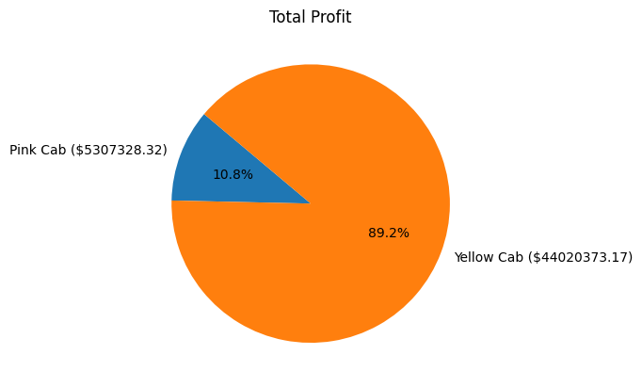
Total Profit Analysis

Slide 7
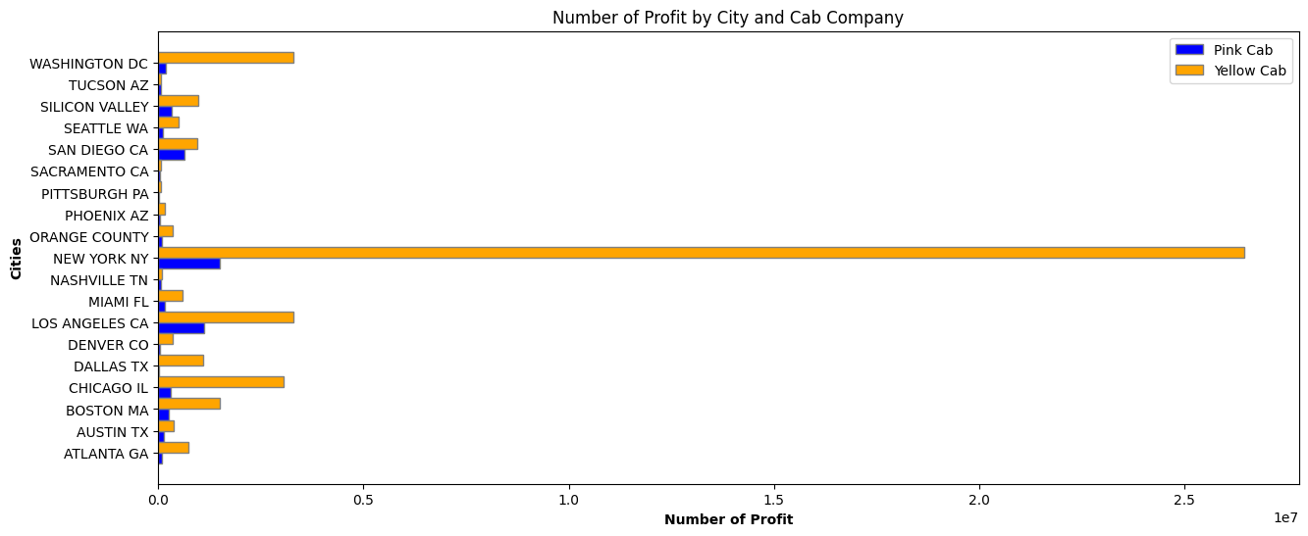
Total Profit Analysis City Wise
Yellow Cab outperforms Pink Cab in most cities, with significantly higher revenues. In New York City, Yellow Cab's revenue is over
10 times higher than Pink Cab's.

Slide 8
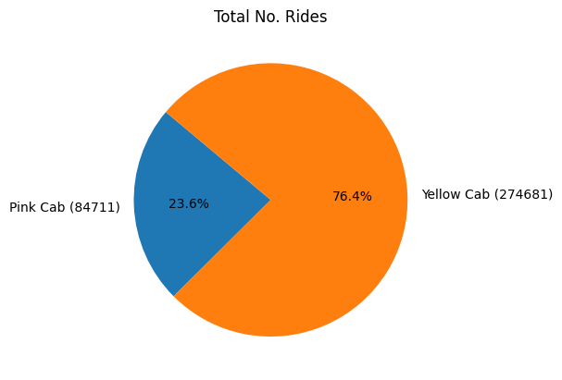
Total Ride Counts
Yellow Cab captures more than 76.04% of the market, leaving Pink Cab with only 23.6% market share.

Slide 9
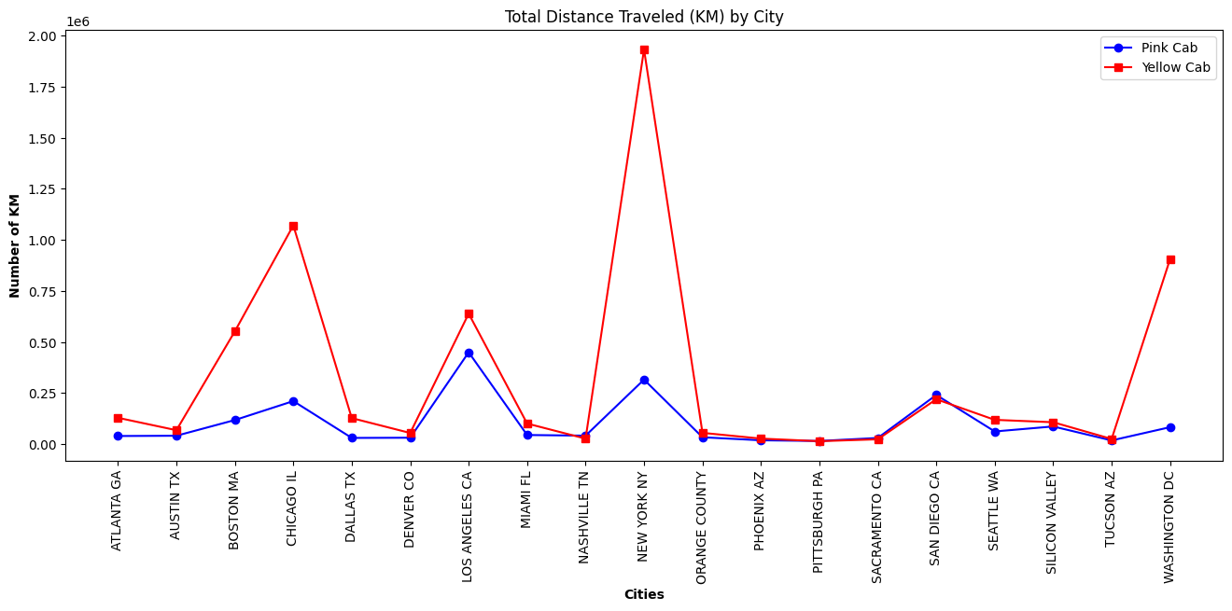
Total Distance Traveled (KM) by City
Profit Analysis
Yellow Cab covers more distance due to its larger customer base.

Slide 10
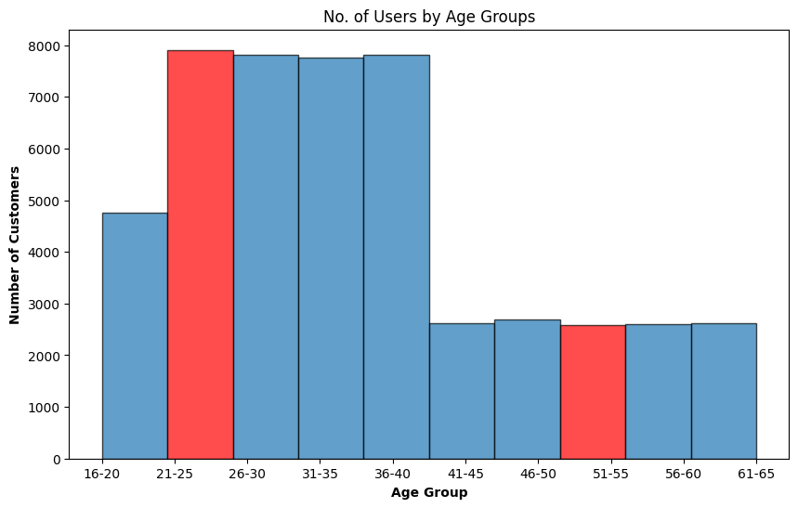
Total Customer Prefernce by Age Group
Profit Analysis
The age group 21-25 shows the highest usage, while usage stay same after the age of 41.

Slide 11
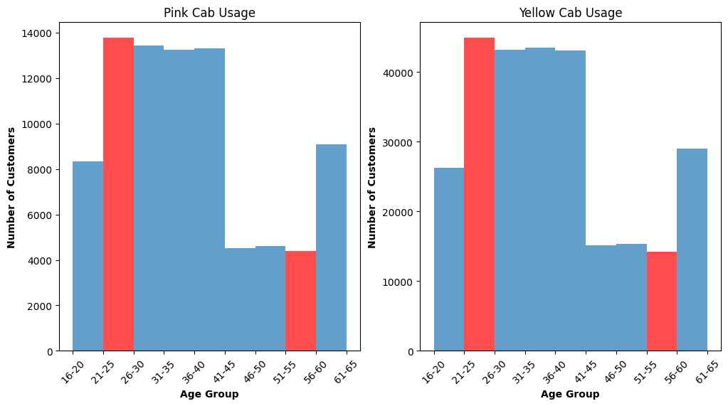
Customer Preferences by Age Group, Segmented by Company
Profit Analysis

Slide 12
Frequncy of use by user the same Cab
Profit Analysis
 | pink cab | yellow cab
count | 46148 | 46148
mean | 1.83 | 5.95
std | 2.19 | 7.96
min | 0.0 | 0.0
25% | 0.0 | 1.0
50% | 1.0 | 2.0
75% | 3.0 | 9.0
max | 18.0 | 47.0
Pink Cab users, on average, utilize the service approximately 1.84 times, whereas Yellow Cab users demonstrate a significantly higher frequency, averaging around 5.95 uses.
Moreover, Yellow Cab stands out with instances where a single user has utilized the service up to a remarkable 47 times, indicating a strong potential for loyal and frequent customers.

Slide 13
Recommendations
Investment Preference:
Considering Yellow Cab's dominant market share, higher profits, and stronger user base, investing in Yellow Cab seems more lucrative than Pink Cab.
Customer Retention:
Develop strategies to retain and attract more customers within the 21-25 age group, as they exhibit the highest usage patterns.
Loyalty Programs:
Capitalize on Yellow Cab's potential for loyal and frequent customers by introducing tailored loyalty programs to further enhance customer retention and increase revenue.
Market Expansion:
Explore opportunities for Yellow Cab to expand its services into new cities or regions, leveraging its strong brand presence and market dominance.
Considering the data presented, investing in Yellow Cab appears to be the more favorable option.

Slide 14
Thank You

